Slide 1

PIZZA SALES AND PERFORMANCE DASHBOARD
A Comprehensive Analysis of Sales, Customer Behavior, and Revenue Insights.
BY: OLIVIA GEORGETTE AGGREY

Slide 2
Overview
The pizza restaurant operates in a highly competitive food service environment where data-driven decision making is essential for growth. To remain competitive, management requires insights into sales performance, customer ordering patterns, product preferences, and revenue contribution across different pizza categories and sizes.
This analysis uses the 2015 pizza sales dataset to explore order behavior, product performance, and revenue drivers through interactive dashboards built in Power BI. The findings highlight the key areas the company should target to maximize revenue, reduce inefficiencies, optimize menu offerings, and improve overall operational performance.

Slide 3
Problem Statement
The restaurant generates thousands of pizza orders each year, but management lacks clear visibility into which products drive the most revenue, how customers order, and which operational patterns affect sales performance. Without a structured analysis of order behavior, product trends, and revenue drivers, the business risks missed opportunities, inefficient resource allocation, and declining profitability.

Slide 4
Project Objectives
The analysis aims to:
Provide a comprehensive overview of sales, revenue, and product performance.
Identify top-selling and low-selling pizzas to support menu optimization.
Analyze customer ordering patterns, including single vs. multi-pizza behavior.
Understand revenue contribution across pizza sizes, categories, and order types.
Reveal peak ordering hours and key demand periods.
Deliver actionable insights that guide strategic decisions and improve performance

Slide 5
Dataset Overview
Source: Pizza Sales Dataset (2015) from @timebokkaraa2 on X
Source URL: CLICK HERE
Time Period: January – December 2015
Rows: 48,665 records
Columns: 12 fields
Key Fields:
Orders → Order ID, Order Date, Order Time
Products → Pizza Name, Pizza Category, Pizza Size, Pizza ID
Sales & Performance → Quantity, Unit Price, Total Price

Slide 6
Methodology
This analysis follows a structured approach:
Data Cleaning & Preparation
  Corrected data types, created calculated columns, and standardized fields.
Data Modeling
  Established relationships between tables to enable accurate filtering and reporting.
  Created measures for revenue, quantity, pizzas per order, and category-level insights.
Exploratory Data Analysis (EDA)
  Identified trends in sales, revenue, customer behavior, and product performance.

Slide 7
Methodology
4. Dashboard Development (Power BI)
  Built interactive visuals for product insights, customer behavior, and order patterns.
  Designed a multi-page report highlighting key performance indicators and insights.
5. Interpretation & Insight Generation
  Drew conclusions from the data to support business recommendations.

Slide 8
Business Questions
Which pizzas generate the highest and lowest revenue?
How does revenue vary by pizza size and category?
What are the peak sales hours, and how do ordering patterns change during the day?
What percentage of orders are single vs multi-pizza orders?
Which pizza categories are preferred by single vs multi-item buyers?
How does monthly revenue trend differ between order types?

Slide 9
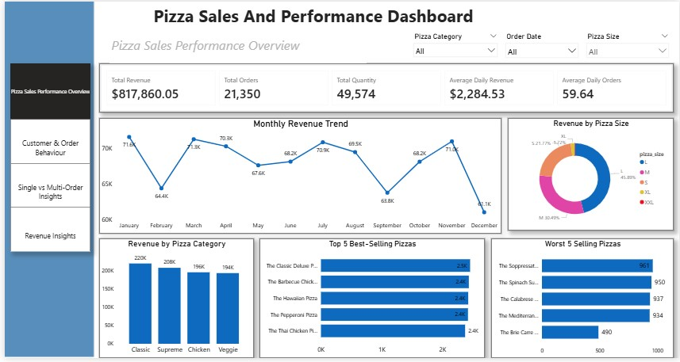
Dashboard

Slide 10
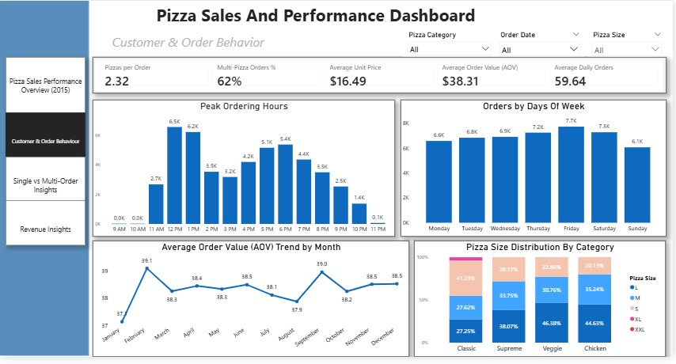
Dashboard

Slide 11
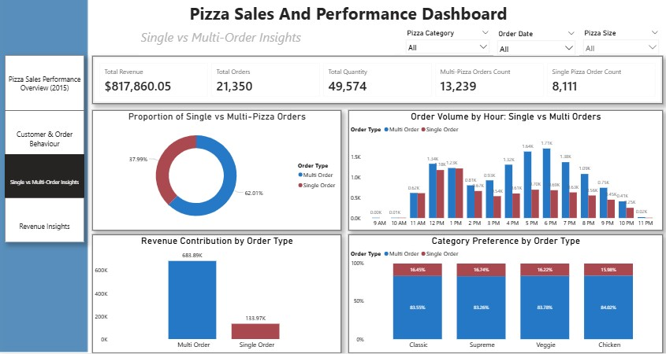
Dashboard

Slide 12
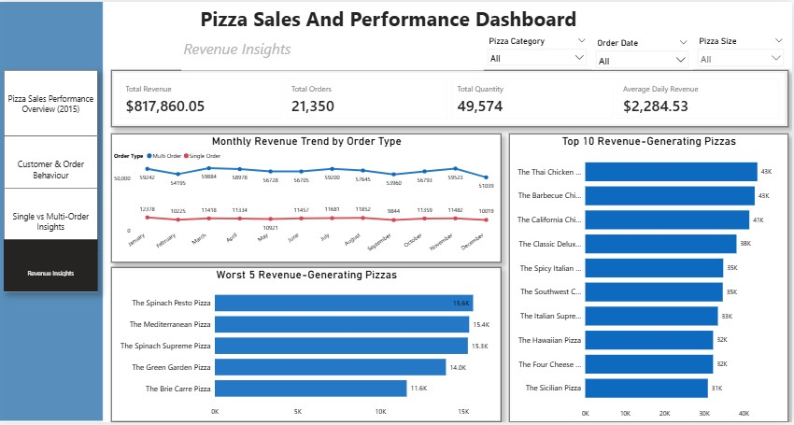
Dashboard

Slide 13
PAGE 1 – SALES PERFORMANCE OVERVIEW
KPIs EXPLAINED
Total Revenue - $817,860.05
This represents the total income generated from all pizza sales in 2015.
Total Quantity Sold – 49,574
Across all orders, 49,574 individual pizzas were sold.
Total Orders – 21,350
A total of 21,350 customer orders were recorded throughout the year.
Average Daily Revenue — $2,284.53
On average, the store generated $2,284.53 in revenue per day.
Average Daily Orders — 59.64
The store fulfilled an average of 59.64 orders per day.

Slide 14
Key Insights
Classic and Supreme pizzas contribute the highest revenue among all categories. Veggie pizzas have the lowest revenue contribution, indicating potential for menu improvement or marketing push.
Revenue peaks in March, July, and November, showing strong seasonal demand. Noticeable dips occur in February, September, and December suggesting these months may need targeted promotions.
The Classic Deluxe, Barbecue Chicken, Hawaiian, Pepperoni and the Thai Chicken Pizzas are the most ordered pizzas.
The Brie Carre Pizza is the least ordered pizza. These least ordered pizzas may need price adjustment or total removal from the menu to reduce losses.
Large-sized pizzas generate the highest revenue, followed by Medium then by Small size. XL and XXL sizes contribute significantly less, suggesting limited customer demand for the extremes.

Slide 15
PAGE 2 –CUSTOMER & ORDER BEHAVIOUR
KPIs EXPLAINED
Pizza Per Order - 2.32
On average, customers purchase about 2 pizzas per transaction.
Multi-Pizza Orders (%) - 62%
62% of Customers order more than one pizza.
Average Unit Price - $16.49
This represents the average selling price per pizza unit, indicating the general pricing level of the pizza menu.
Average Order Value (AOV) - $38.31
Customers spend approximately $38 per order on average.
Average Daily Orders — 59.64
The store fulfilled an average of 59.64 orders per day.

Slide 16
Key Insights
Peak Ordering Hours occurs between 12pm and 1pm in the afternoon likely due to lunch orders and also between 5pm and &pm due to dinner orders.
Friday and Saturday show the highest order volumes, indicating strong weekend demands.
The highest AOV appears around February and September indicating higher-value customer spending. The lowest AOV occurs around January and August.
Large pizzas make up the biggest share across most categories. XL and XXL pizzas appear in very small proportions, indicating they are rarely ordered across all categories

Slide 17
PAGE 3 –SINGLE VS MULTI ORDER BEHAVIOUR
KPIs EXPLAINED
Multi-Pizza Orders Count – 13,239
This represents the total number of orders where customers bought more than one pizza.
Single Pizza Orders Count – 8,111
This shows the number of orders where only one pizza was purchased.

Slide 18
Key Insights
62% of all orders are multi-pizza orders, while 38% are single-pizza orders. Customers typically order for groups, families, or shared meals.
Multi-pizza orders generate over 80% of total revenue, significantly higher than single orders. The revenue gap shows that large orders are the primary driver of business performance.
Multi orders spike between 5pm to 7pm confirming dinner-time group demand. Single orders spike at 1pm confirming lunch time demand.
Multi-orders consistently dominate in all categories – Classic, Supreme, Veggie and Chicken. The Chicken category shows the highest multi-order share, suggesting it is the go-to option for group orders. Single orders appear more evenly spread across categories but remain a minority.

Slide 19
Key Insights – Page 4 Revenue Performance
Multi-order revenue remains significantly higher across all months. A slight dip occurs for both orders in February, September and December.
The top performers are dominated by Classic and Supreme categories, led by The Thai Chicken Pizza, The Barbecue Chicken Pizza and The California Chicken Pizza. These pizzas contribute the highest revenue, indicating strong customer preference for chicken-based and classic flavors.
The lowest revenue generating pizzas include The Brie Carre Pizza, The Green Garden Pizza and The Spinach Supreme Pizza. These items may require menu re-evaluation, promotional strategies or targeted marketing

Slide 20
Recommendation
Boost Multi-Pizza Sales: Expand combo deals and group offers to maintain strong multi-order demand.
Fix Low Performers: Review ingredients, pricing, and marketing for the worst-selling pizzas.
Use Peak Hours Smartly: Increase staffing during peak hours and promote discounts during slow hours.
Optimize Menu Mix: Stock more Classic, Supreme, and Chicken pizzas; promote Large/Medium sizes.
Seasonal Planning: Increase campaigns in high-revenue months and recovery promos in slower months.

Slide 21
Conclusion
The business shows strong overall performance with steady customer demand.
Multi-pizza orders and large and medium sized pizzas drive most of the revenue.
Classic and Supreme pizzas remain customer favorites, while low-performing pizzas need review.
These insights support better menu decisions, marketing, and operations.

Slide 22

THANK YOU

